Slide 1
Meet Your Advisory Board!
Meet Your Advisory Board!

Slide 2
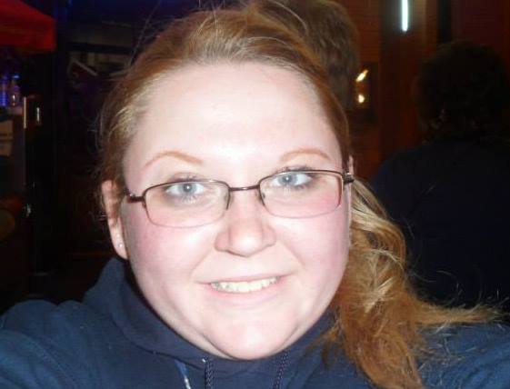
President: Megan Spreeman
Age: 21
Status: Junior
Major: Political Science (Pre-Law)
Minors: Communications and Journalism and Adolescent Psychology and Law
Certificate: American Sign Language
Future Career: Lawyer and Politician

Slide 3
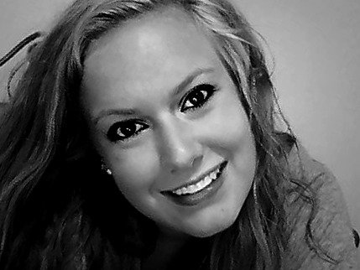
Vice President: Kelsey Leaf
Age: 19
Status: Sophomore
Major: Marketing (Sales)
Future Career: Not completely sure but looking at marketing director or sales representative.

Slide 4
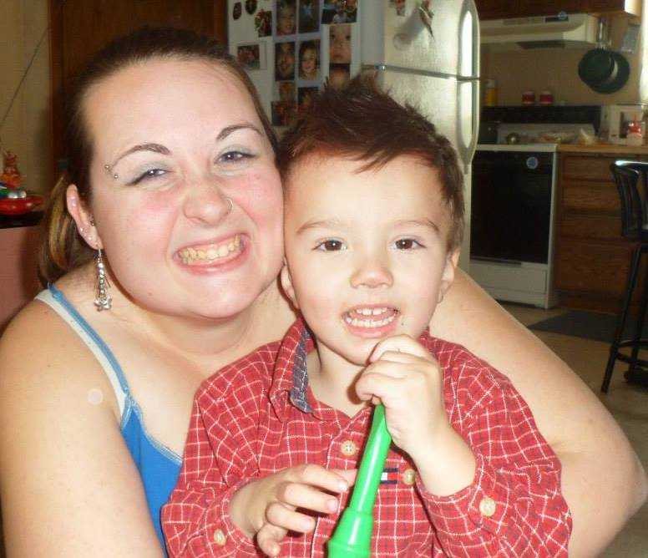
Secretary: Erin Riddle
Age: 23
Status: Senior
Major: Criminal Justice
Minor: None but achieving an American Sign Language certificate!
Future Career: Institutional AODA Counselor

Slide 5
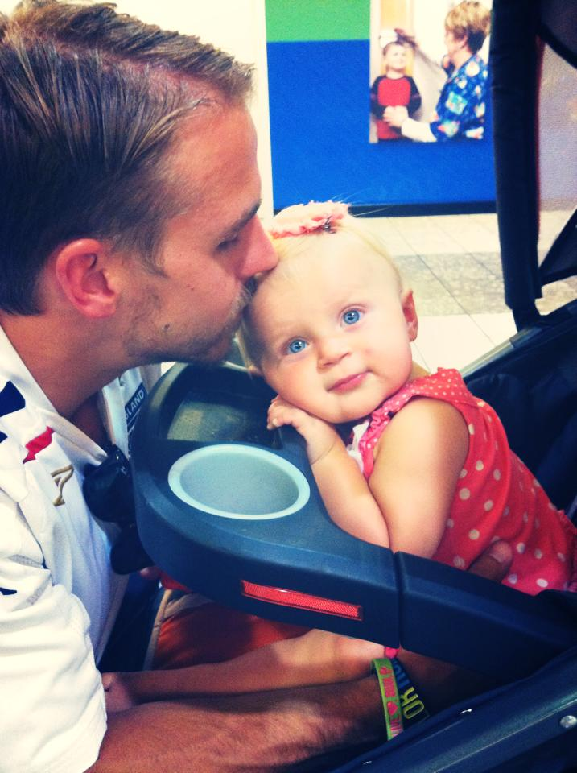
Treasurer: Matt Dillon
Age: 28
Status: Second Year MBA Student
Major: Human Resource Management
Career: Currently pursuing my MBA and working my way back into the Human Resources profession, where I spent the first four years of my career.

Slide 6
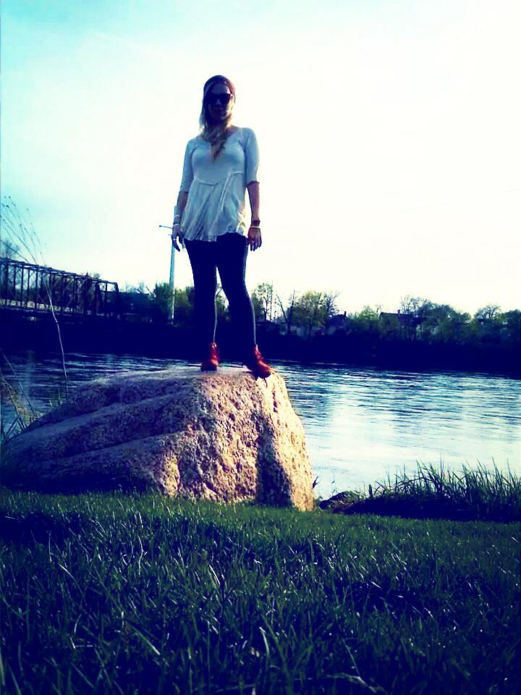
Co-Treasurer: Abby Schroeder
Age: 24
Major: Psychology
Minor: Family Studies
Future Career: Spiritual Psychologist

Slide 7
Coming Together to Help YOU and your LOVED ONES to gain a healthier lifestyle! We hope to see you soon!

